Slide 1






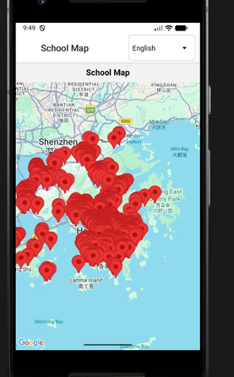
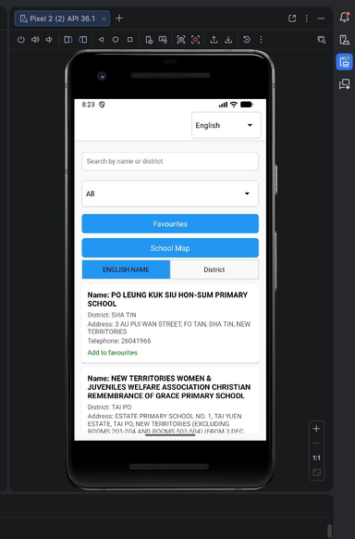
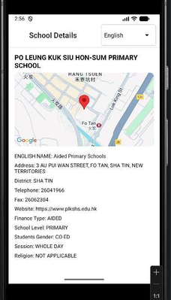
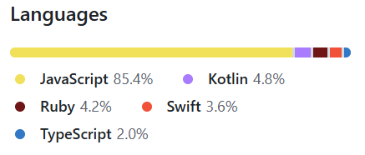
COMP 3130SEF Mobile Application Programming
HK School Explorer
ACKNOWLEDGMENTS
RESULTS
Google Map API
DATA.GOV.HK
Multi-screen navigation with React Navigation
Provides locations services and map integration
UI/UX: Vector icons, gesture handling, safe area support, animations, Dropdown/picker components
School list view with infinite scroll
School detail screen, search
Advanced filter, Map view, Bookmark (favorite)
Recent view System, Multilingual support
SUMMARY
A React Native project
Support real-time geolocation tracking
Map rendering
Favorites, Recently reviewed, School map, Multilingual support
Filter (School level, Finance type, etc.)
METHODS
Framework
React 19.2.3
React Native 0.84.1
Node.js ≥ 22.11.0
Development Tools
Map Rendering & Routing: Google Maps +
react-native-maps
API Fetching: Axios
Local Storage: AsyncStorage
Multilingual: i18next
Build: Metro Bundler, Babel 7.25.2
Platform Support: Android via Gradle
FURTHER INFO
Provide directions route to the selected school
Add the target school to favorite (bookmark) for easy searching and offline usage

